Slide 1

S.S.V.P.S’s B. S. Deore Polytechnic, Dhule
Department of Computer Engineering
AcademicYear : 2026-2027
SEMINAR AND PROJECT INITIATION COURSE
Sem :CO 5K
SPI – 315003
Date : 17-10-2026
Topic : Crop Disease Detection
Roll No.
Name Of The Student
8
Ansari Sana Salim
26
Shrushti Dipaksingh Girase
50
Pathan Zoha Khan Ferozkhan
55
Hiteshri Gorakh Patil

Slide 2
Contents
  Abstract
1. Introduction
2.Literature Review
3.Information to Seminar topic
4.Advantages and Disadvantages
5. Conclusion
6.Project Initiation :
6. 1 Description of problem statement.
6. 2 Scope and objectives.
6. 3 Stake holder
6. 4 seminar exsicussion plan
6.5 Platform/ Equipment/ Resources identification.
7. Bibliography
8. References

Slide 3
Abstract
Crop Disease Detection is a technology-based system that identifies plant diseases using crop leaf images. It uses image processing and deep learning techniques, such as Convolutional Neural Networks (CNN), to classify leaves as healthy or diseased. The system aims to provide fast and easy disease detection, helping farmers take timely preventive measures, reduce crop losses, and improve agricultural productivity.
‹#›

Slide 4
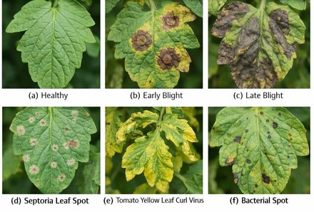
1. Introduction
Agriculture is an important part of our lives, but crop diseases can reduce crop
quality and production. Traditional methods of disease detection require manual inspection and expert knowledge, which can be time-consuming.
Our project, Crop Disease Detection, uses image processing and deep learning techniques to identify diseases from crop leaf images. It aims to detect diseases at an early stage, help farmers take timely action, reduce crop losses, and improve agricultural productivity through modern technology.

Slide 5
2.Literatutre Survey
Sr. No | Approach Types | Technologies Used | Dataset | Key Objectives | Limitations
1 | Deep Learning | CNN, AlexNet, GoogLeNet | PlantVillage – 54,306 images | Detect and classify plant diseases automatically. | Controlled images; poor generalization to field conditions.
2 | Deep Learning | Deep CNN, ECOC classifier | PlantVillage – tomato leaf images | Identify and classify tomato leaf diseases. | Limited to selected tomato diseases; field testing is limited.
3 | Image Segmentation + DL | CNN, image segmentation | Segmented plant leaf images | Improve disease classification by removing unnecessary background information. | Segmentation errors may affect classification accuracy.

Slide 6
2.Literatutre Survey
Sr. No. | Approach Type | Technology Used | Dataset | Key Objective | Limitations
4 | Image Processing | Segmentation, feature extraction, classification | Plant leaf images | Identify diseased portions of leaves and classify plant diseases. | Performance depends on image quality and selected features.
5 | Hybrid Deep Learning | Convolutional Autoencoder (CAE), CNN | PlantVillage peach leaf images | Build a compact model to detect bacterial spot disease. | Limited crop and disease coverage.
6 | Object Detection | Improved YOLOv4 | Apple disease images from orchard-like conditions | Detect and locate disease spots in real time. | Requires annotated images and computational resources.

Slide 7
2.Literatutre Survey
Sr. No. | Approach Type | Technology Used | Dataset | Key Objective | Limitations
7 | Transfer Learning | DenseNet-121, ResNet-50, VGG-16, Inception V4 | PlantVillage – 54,305 images, 38 classes | Compare pretrained models for multiple crop disease classes. | Controlled dataset may not represent real field conditions.
8 | Literature Review | CNN, DCNN, transfer learning, data augmentation | PlantVillage, Kaggle, and other research datasets | Review CNN-based plant leaf disease detection techniques. | Dataset diversity and real-world validation remain challenging.
9 | CNN-Based Classification | Custom 5-layer CNN, VGG-16, VGG-19, Xception, ResNet | Rice leaf images – 1,600 images | Detect and classify rice leaf diseases for early diagnosis. | Relatively small dataset may limit generalization.

Slide 8
2.Literatutre Survey
Sr. No. | Approach Type | Technology Used | Dataset | Key Objective | Limitations
10 | Deep Learning + Explainable AI | Grad-CAM, Grad-CAM++, LIME, Captum | Rice leaf dataset – 7,420 images | Classify rice diseases and explain predictions visually. | Insufficient disease samples and limited generalization testing.
11 | Hyperspectral Image Analysis | VNIR/SWIR imaging, machine learning, image processing | Capsicum plants infected with Tomato Spotted Wilt Virus | Detect infection using spectral information from plant leaves. | Requires specialized imaging equipment and processing.
12 | Transfer Learning / Deep Learning | Pretrained CNN models and ensemble learning | Rice leaf disease images | Improve rice disease classification by comparing and combining pretrained models. | Performance depends on dataset size, image diversity, and computational resources.

Slide 9
3. Information To Seminar Topic
Crop Disease Detection is a technology-based approachusedto identifydiseasesin
plants by analysing images of their leaves. Crop diseases can affect plant growth, reduce crop quality, and cause agricultural losses.
This system uses image processing, machine learning, and deep learning techniques such as Convolutional Neural Networks (CNN) to classify crop leaves as healthy or diseased. It can help farmers identify possible diseases early and take suitable preventive measures.
The main aim of this project is to make disease detection faster, easier, and more efficient. In the future, this technology can be improved to support more crops and disease types through web and mobile applications.
‹#›

Slide 10
1. Technology Used:Artificial Intelligence (AI), Machine Learning (ML), Convolutional Neural Networks (CNN), Python, OpenCV, and TensorFlow are used to analyze crop leaf images and identify possible diseases.
2. Approach:The system collects or accepts crop leaf images, preprocesses them, and analyzes them using a trained CNN model. The model predicts whether the crop is healthy or affected by a particular disease and displays the result.
3. Main Purpose:The main purpose is to detect crop diseases at an early stage using image processing and AI techniques, helping farmers make better decisions about crop health.
4. Key Concepts:The key concepts include image preprocessing, feature extraction, deep learning, image classification, model training, and performance evaluation.
5. Benefits:It supports early disease identification, saves time, reduces manual effort, and helps farmers manage crop health more effectively. It can also provide preliminary disease information quickly.
6. Applications:Crop Disease Detection can be used in smart farming, greenhouses, plant nurseries, agricultural research, farmer advisory systems, and mobile-based agricultural applications.
‹#›

Slide 11
4. Advantages / Disadvantages
Advantages:
Detects crop diseases at an early stage. Saves time and manual effort.
Helps reduce crop losses.
Provides fast disease identification. Supports smart and modern farming.
Disadvantages:
Requires a good-quality image dataset.
Poor images may give incorrect results.
May detect only trained disease types.
Requires computing resources for model training. Accuracy depends on the quality of the dataset.
‹#›

Slide 12
5. Conclusion
Crop Disease Detection is a useful application of modern technology in agriculture. By using image processing, Machine Learning, and Deep Learning, the system can help identify possible crop diseases from leaf images. Early detection allows farmers to take timely action and manage crops more effectively. Although challenges such as image quality and model accuracy remain, this technology has the potential to reduce crop losses and improve agricultural productivity.

Slide 13
6. Project Initiation
  The project initiation phase focuses on identifying the problem and planning the proposed Crop Disease Detection System.
1.Problem Identification: Identified the need for early detection of crop diseases to
reduce crop losses.
2.Project Objectives: Aim to detect and classify crop diseases using images of
plant leaves.
3.Literature Review: Studied existing research papers on AI-based crop disease
detection.
4.Research Gap: Examined the limitations of existing approaches, such as
performance under real-field conditions and dependence on internet
connectivity.
5.Technology Selection: Considered Artificial Intelligence, Deep Learning, and
Image Processing for disease detection.
6.Feasibility Study: Evaluated the technical requirements, available resources,
and feasibility of the proposed system.
7.Project Scope: Defined the basic functions and expected outcomes of the
system.

Slide 14
6.1 Description of Problem Statement
Crop Disease Detection Using Deep Learning is an AI-based project designed to identify plant diseases from leaf images. It uses deep learning techniques, such as Convolutional Neural Networks (CNN), to classify crop leaves and detect possible diseases. This system can help farmers identify diseases early and take appropriate action. The main aim of the project is to support smart agriculture, reduce crop losses, and improve crop health.

Slide 15
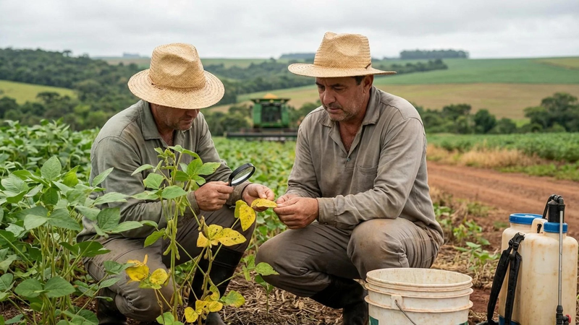
6.2 Scope and Objectives.
  Detect crop diseases using plant leaf images.
  Identify healthy and diseased leaves.
  Support early detection of crop diseases.
  Use AI and Machine Learning for disease classification.
  Reduce the time and effort required for disease identification.
  Help farmers take timely preventive measures and reduce crop losses.
  Improve crop monitoring and agricultural productivity through modern technology.

Slide 16
6.3 Stake Holder
Farmers
Agricultural experts Researchers
Students and developers Agricultural organizations
‹#›

Slide 17
6.4 Seminar exsicussion plan
Study existing crop disease detection methods. Collect information and relevant datasets. Understand image processing and ML techniques. Design the system workflow.
Test the model and evaluate its performance. Prepare the final report and presentation.
‹#›

Slide 18
6.5 Platform/ Equipment/ Resources
Hardware:
Computer or laptop, camera or smartphone.
Software: Libraries:
Python, Jupyter Notebook or Google Colab.
OpenCV, TensorFlow or Keras, NumPy.
Dataset:
PlantVillage or other suitable crop leaf datasets.
‹#›

Slide 19
7.Bibliography
  Books
  Digital Image Processing – Rafael C. Gonzalez and Richard E. Woods.
  DeepLearning – Ian Goodfellow, Yoshua Bengio, and Aaron Courville.
  Websites
  PlantVillage: https://plantvillage.psu.edu/
  TensorFlow: https://www.tensorflow.org/
  OpenCV: https://opencv.org/
  Frontiers in Plant Science: https://www.frontiersin.org/journals/plant-science

Slide 20
8.References
TO-BE-Filled (2016) Pollinators vital to our food supply under threat.
UNEP(2013) Smallholders, food security, and the environment
ITU (2015) Ict facts and figures– the world in 2015
Sanchez PA, Swaminathan MS (2005) Cutting world hunger in half
Lin M, Chen Q, Yan S (2013) Network in network. arXiv preprint arXiv:1312.4400
  Altieri, M.A. Agroecology: The Science of Sustainable Agriculture; CRC Press: Boca Raton, FL, USA, 2018.
  Gebbers, R.; Adamchuk, V.I. Precision agriculture and food security. Science 2010, 327, 828–831. [CrossRef] [PubMed]
  Tai AP, Martin MV, Heald CL (2014) Threat to future global food security from climate change and ozone air pollution. Nature Climate Change 4(9):817–821.
  Carvalho, F.P. Agriculture, pesticides, food security and food safety. Environ. Sci. Policy 2006, 9, 685–692. [CrossRef]
  McCulloch, W.S.; Pitts, W. A logical calculus of the ideas immanent in nervous activity. Bull. Math. Biophys. 1943, 5, 115–133. [CrossRef]
‹#›

Slide 21
  Hinton, G.E.; Osindero, S.; Teh, Y.-W. A fast learning algorithm for deep belief nets. Neural Comput. 2006, 18, 1527–1554.
  [CrossRef] Heaton, J.; Polson, N.; Witte, J.H. Deep learning for finance: Deep portfolios. Appl. Stoch. Models Bus. Ind. 2017, 33, 3–12. [CrossRef]
  LeCun Y et al. (1989) Backpropagation applied to handwritten zip code recognition. Neural computation 1(4):541–551.
  He K, Zhang X, Ren S, Sun J (2015) Deep residual learning for image recognition. arXiv preprint arXiv:1512.03385.
  Simonyan, K.; Zisserman, A. Very deep convolutional networks for large-scale image recognition. arXiv 2014, arXiv:1409.1556.
  Zeiler MD, Fergus R (2014) Visualizing and understanding convolutional networks in Computer vision–ECCV 2014. (Springer), pp. 818–833.
  Ghoury, S., Sungur, C., and Durdu, A. Real-time diseases detection of grape and grape leaves using faster r-cnn and ssd mobilenet architectures. In International conference on advanced technologies, computer engineering and science (ICATCES 2019), pages 39–44, 2019.

Slide 22
  Abdelmoamen Ahmed, A., & Harshavardhan Reddy, G. (2021). A mobile-based system for detecting plant leaf diseases using deep learning.
  AgriEngineering, 3(3), 478–493. https://doi.org/10.3390/ agriengineering3030032 Adhao, A.S. and Pawar, V.R. Machine learning regression technique for cotton leaf disease detection and controlling using iot 2017 International conference of Electronics, Communication and Aerospace Technology (ICECA), 2:449–454, 2017.
  Agrios, G.N. (2005). Plant Pathology. Elsevier Science.
  Amara, J., Bouaziz, B., & Algergawy, A. (2017). A deep learning-based approach for banana leaf diseases classification. BTW.
  Chiu, Y.-C., Tsai, C.-Y., Ruan, M.-D., Shen, G.-Y., and Lee, T.-T. Mobilenet-ssdv2: An improved object detection model for embedded systems. In 2020 International conference on system science and engineering (ICSSE), pages 1–5. IEEE, 2020.

Slide 23
Thank you
‹#›

